Slide 1

CLSTL 2019
Indian Institute of
Technology Gandhinagar
Managing Research Information at an
Academic Library
Maria João Amante, maria.amante@iscte-iul.pt
ISCTE-IUL
28 February – 02 March 2019

Slide 2
MANAGING RESEARCH INFORMATION AT AN ACADEMIC LIBRARY
SUMMARY
  Mission
  Values
  Challenges
  Research Information Management
  Conclusion

Slide 3
MANAGING RESEARCH INFORMATION AT AN ACADEMIC LIBRARY
MISSION
Powering Sustainable Knowledge in the Digital Age
VALUES
Collaboration and Inclusivity
  High-quality services for all users
  Intellectual freedom and access to scholarship
  Collaboration with partners at all levels
  Stewardship of collections and institutional resources (all formats)
  Innovation and a willingness to embrace opportunities for change
  Inclusivity and equality of opportunities for all users

Slide 4
MANAGING RESEARCH INFORMATION AT AN ACADEMIC LIBRARY
“… libraries are positioned as a hub around which researchers, collections and service development come together.”
Kristina Hourmia-Poutanan (LIBER President)
Research Libraries Powering Sustainable Knowledge in the Digital Age: LIBER Europe Strategy 2018 – 2022 (The Hague, 16 November,2017)

Slide 5
MANAGING RESEARCH INFORMATION AT AN
ACADEMIC LIBRARY
CHALLENGES (Major Advancements)
  Innovative scholarship communication
  Digital skills and services
  Research infrastructures

Slide 6
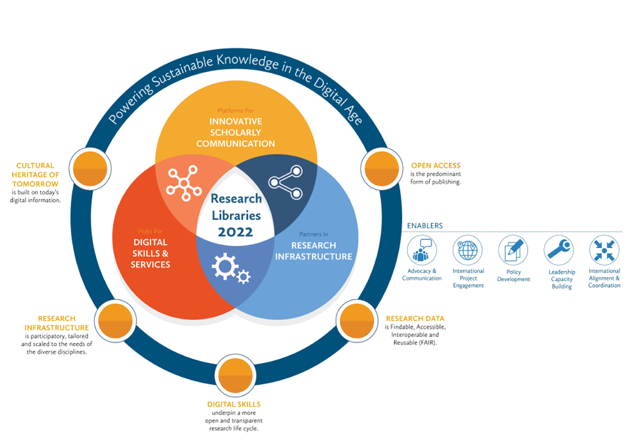
MANAGING RESEARCH INFORMATION AT AN ACADEMIC LIBRARY
  LIBER Europe Strategy 2018 -2022

Slide 7
MANAGING RESEARCH INFORMATION AT AN ACADEMIC LIBRARY
Powering Sustainable Knowledge in the Digital Age implies:
  Open Access as the predominant form of publishing
  Research Data is Findable, Accessible, Interoperable and Reusable (FAIR)
  Digital skills support a more open and transparent research life cycle
  Research infrastructure is participatory
  The cultural heritage of tomorrow is built on today’s digital information
  .

Slide 8






MANAGING RESEARCH INFORMATION AT AN
ACADEMIC LIBRARY

Slide 9
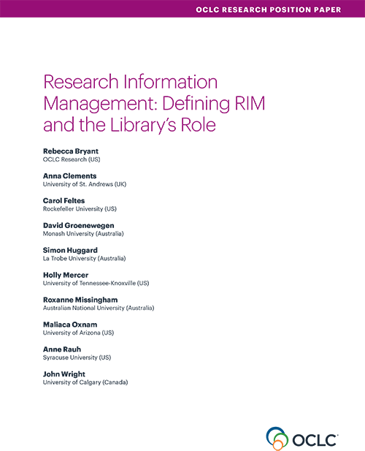
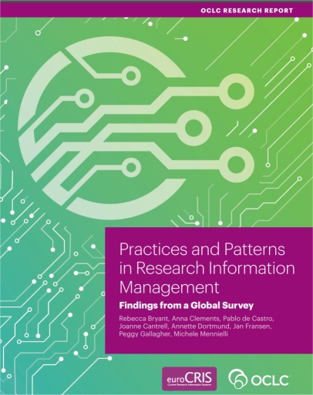
MANAGING RESEARCH INFORMATION AT AN
ACADEMIC LIBRARY
2017
2018

Slide 10
MANAGING RESEARCH INFORMATION AT AN ACADEMIC LIBRARY
Research information management (RIM) is an emerging library service area that involves the collection and curation of metadata on campus research activity. (…) generally includes data from the entire life cycle of a research project, from grant application metadata to impact metrics for the research output. (Library Connect, May 1,2018)
https://libraryconnect.elsevier.com/articles/research-information-management-emerging-library-role
Research information management (RIM) is the aggregation, curation, and utilization of information about research and is emerging as an area of increasing interest and relevance in many university libraries. (…) RIM adoption offers libraries new opportunities to support institutional and researcher goals. (OCLC, 2017)
https://www.oclc.org/research/publications/2017/oclcresearch-defining-rim.html

Slide 11
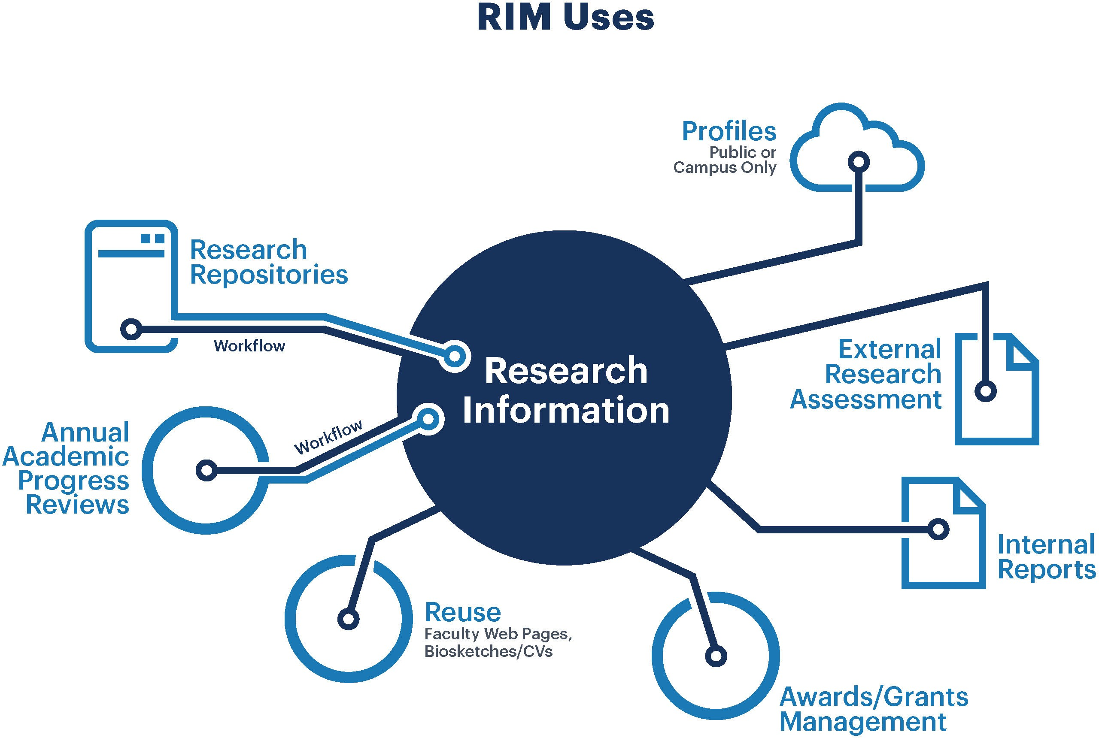
MANAGING RESEARCH INFORMATION AT AN ACADEMIC LIBRARY
OCLC (2017). Research Information Management: Defining RIM and the Library’s Role. p. 8
https://www.oclc.org/content/dam/research/publications/2017/oclcresearch-defining-rim-2017-a4.pdf

Slide 12
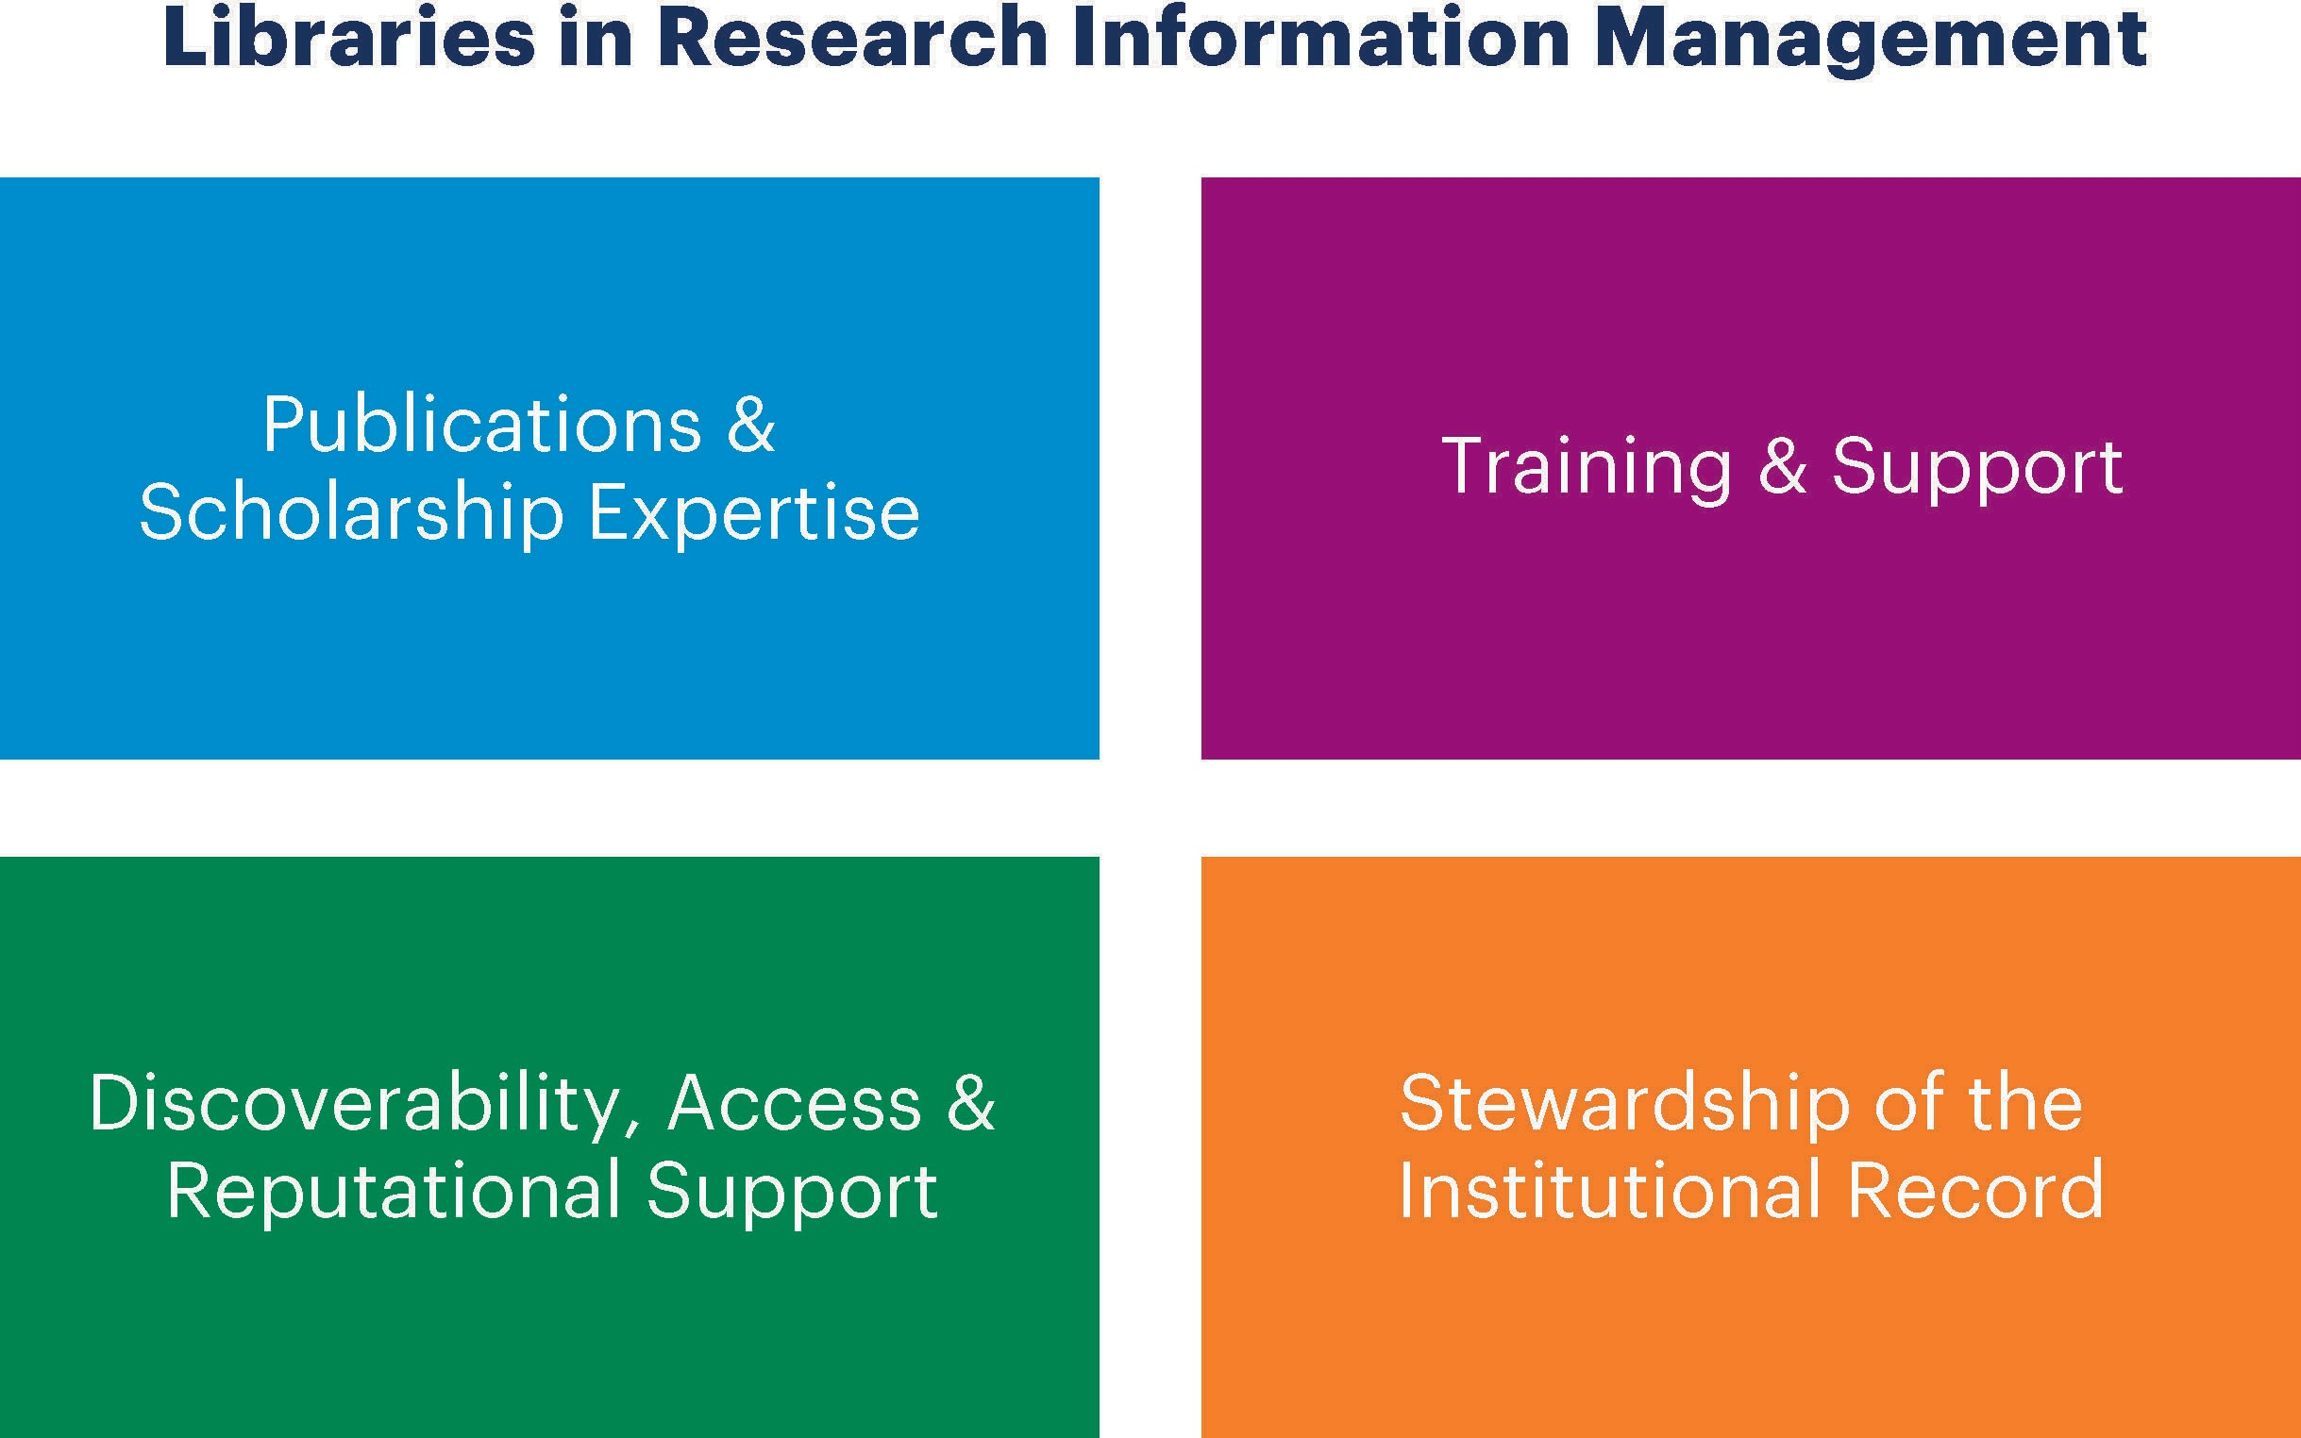
MANAGING RESEARCH INFORMATION AT AN ACADEMIC LIBRARY
OCLC (2017). Research Information Management: Defining RIM and the Library’s Role. p. 13
https://www.oclc.org/content/dam/research/publications/2017/oclcresearch-defining-rim-2017-a4.pdf

Slide 13
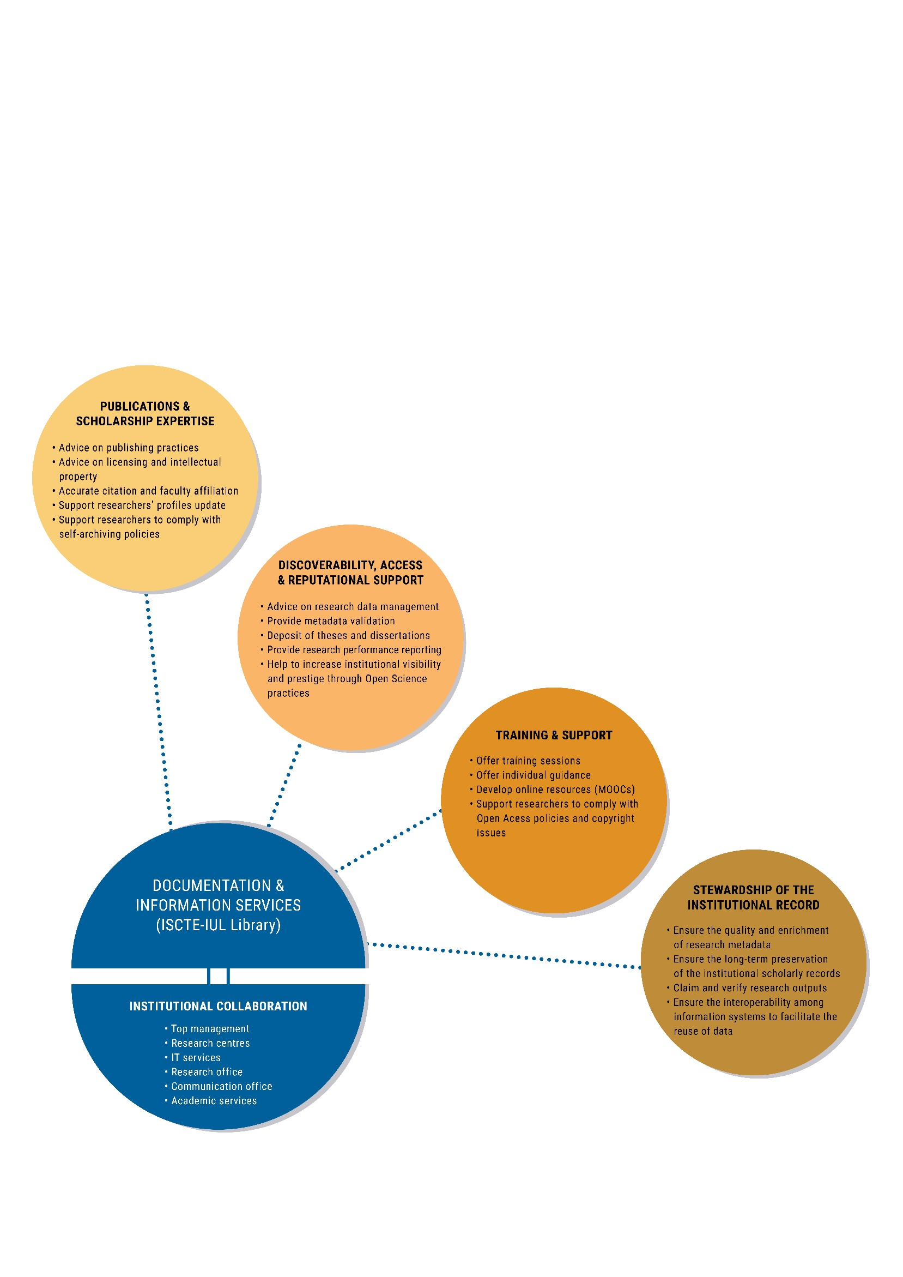
RESEARCH INFORMATION MANAGEMENT AT AN ACADEMIC LIBRARY

Slide 14
INSTITUTIONAL COLLABORATION
  Top management
  Research centres
  IT services
  Research support office
  Communication and media office
  Academic services
SID
ISCTE-IUL Library
Institutional Collaboration

Slide 15
PUBLICATIONS & SCHOLARSHIP EXPERTISE
  Advising on publishing practices (different types of open access publishing namely APCs)
  Advising on licensing (creative commons), intellectual property and copyright
  Ensuring accuracy of citation and faculty affiliation
  Ensuring researchers’ profiles update
  Advising researchers on how to comply with self-archiving policies (institutional, national, European and international level)

Slide 16
DISCOVERABILITY, ACCESS &
REPUTATIONAL SUPPORT
  Advising on research data management
  Providing metadata validation
  Depositing Theses and Dissertations
  Providing research performance reporting (metrics)
  Helping to increase institutional visibility and prestige through Open Science practices

Slide 17
TRAINING & SUPPORT
  Supporting researchers to comply with Open Access policies and copyright issues (institutional, national, European and international level)
  Offering training sessions (metrics, researchers profiles, open access practices, data management practices)
  Offering individual guidance
  Developing online resources (MOOCs)

Slide 18
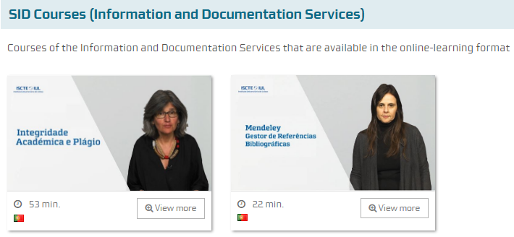
TRAINING & SUPPORT: online resources (MOOCs)

Slide 19
STEWARDSHIP OF THE INSTITUTIONAL RECORD
  Ensuring the quality and enrichment of research metadata
  Ensure the long-term preservation of the institutional
  scholarly records
  Claiming and verifying research outputs (SCOPUS and
  Web of Science)
  Ensuring the interoperability among information systems
  to facilitate the reuse of data (CRIS System and Repository)

Slide 20
RESEARCH INFORMATION MANAGEMENT AT AN ACADEMIC LIBRARY
CONCLUSION
Being embedded in the research process allows libraries and library professionals:
  To acquire more visibility
  To demonstrate the value, relevance and the social and economic impact of their work
  To advocate for libraries and for library professionals
  To participate on research life cycle and policies of the institution
  To influence copyright policies

Slide 21
RESEARCH INFORMATION MANAGEMENT AT AN ACADEMIC LIBRARY
CONCLUSION
Being embedded in the research process allows libraries and library professionals:
  To engage in regional, national and international projects and initiatives
  To act as a partner and not as a support service in learning, teaching and research activities
  To continuously reinvent the Library
  To align Library objectives with the organization strategic objectives

Slide 22


Slide 23

Maria João Amante
maria.amante@iscte-iul.pt
http://orcid.org/0000-0001-8891-9094
Clara Parente Boavida
clara.boavida@iscte-iul.pt
http://orcid.org/0000-0002-4837-6395
João Dias
joao.carlos.dias@iscte-iul.pt
http://orcid.org/0000-0002-0751-837X
This work is licensed under a creative commons attribution 4.0 International License.

